Slide 1

Assignment topic: Neural Network Models for Object Recognition
Master in Artificial Intelligence
Module: Machine Learning

Slide 2
Table of content
Introduction
Data loading and preprocessing
CNN Architecture
Model Summary
Model Compilation
Model Training
Model Evaluation
Conclusion
References

Slide 3
1. Introduction
AI technologies are more and more integrated in daily life in several areas
Computer vision is considered to be the biggest success story of deep learning
Deep vision models are part of our life and will be part of our future; e.g. YouTube, PCR software, Google image search, robotics, autonomous driving

Slide 4
2. Data loading and preprocessing
CIFAR-10 image dataset
Data normalization
  Adjust pixel values of images
  Ensure all input features are on similar scale
  Makes the training process more stable and efficient
One-hot encoding
  Transform the categorical class labels to a binary matrix representation
  Ensure that labels have been converted into a suitable format for the classification task
  Ensure that the training and evaluation metrics, such as accuracy, are more interpretable and understandable
Data split
  Train – evaluate – test

Slide 5
3. CNN Architecture
Extracts features from images, reduces their dimensionality, and performs classification using fully connected layers.
2 Convolutional Layers
  First one with 32 filters, size 3x3, applied to input image of shape
  Second one with 64 filters, size 3x3, applied to the output of the first convolutional layer
Activation Function (ReLU)
  Applied after each convolutional layer to introduce non-linearity
Max Pooling Layers
  2 max-pooling layers, both with a pool size of 2x2

Slide 6
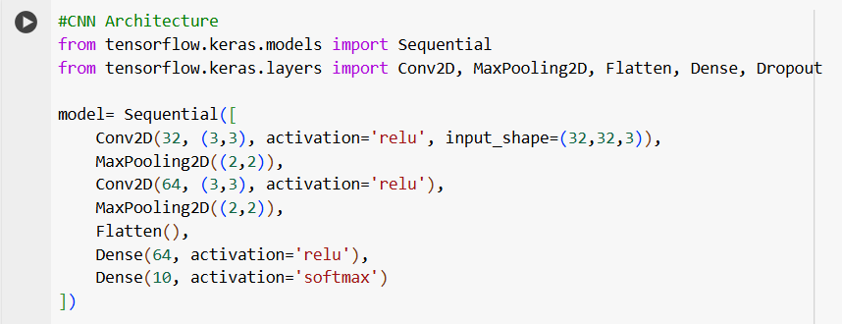
3. CNN Architecture
Flattening
2 Fully Connected Layers (Dense)
  First one with 64 neurons uses ReLU activation
  Second one with 10 neurons uses softmax activation
Activation Function (Softmax)
  Applied in the output layer for multi-class classification

Slide 7
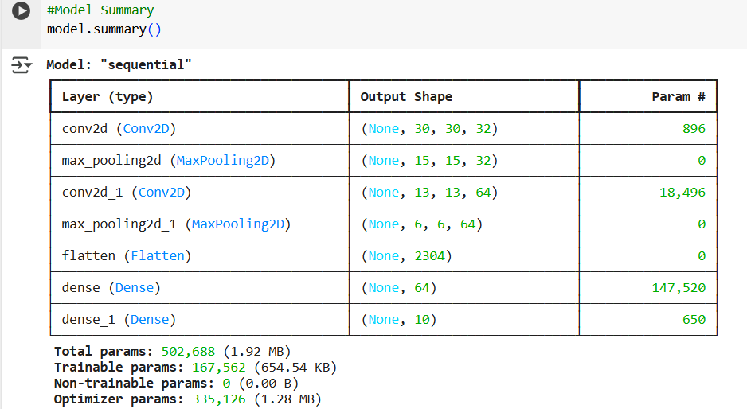
4. Model Summary
  Layer-by-layer breakdown

Slide 8
5. Model Compilation
  Configuration of the learning process before training
  Optimiser: Adam
  Loss Function: “categorical_crossentropy”
  Metrics: accuracy

Slide 9
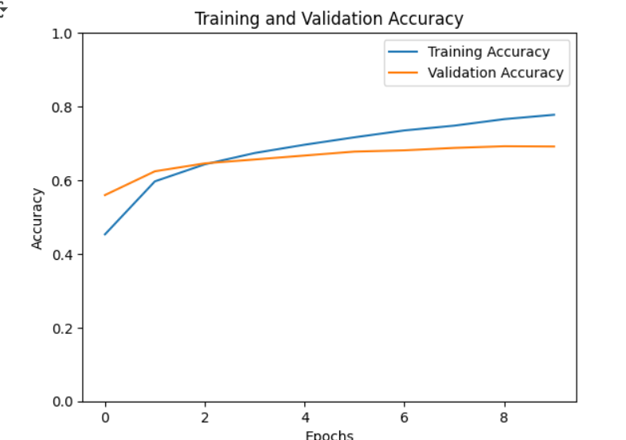
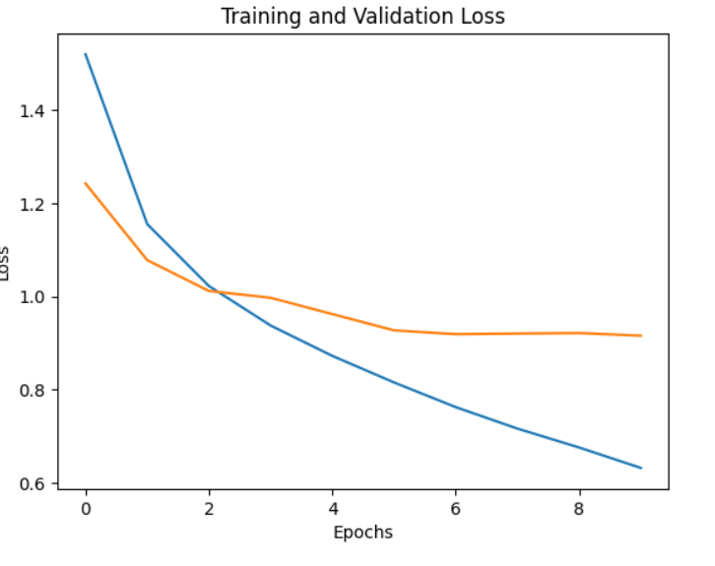
6. Model Training
  Process where the model learns from the data to get better
  Epochs: 10
  Batch size: 1250
  Training Accuracy: 78,45%

Slide 10
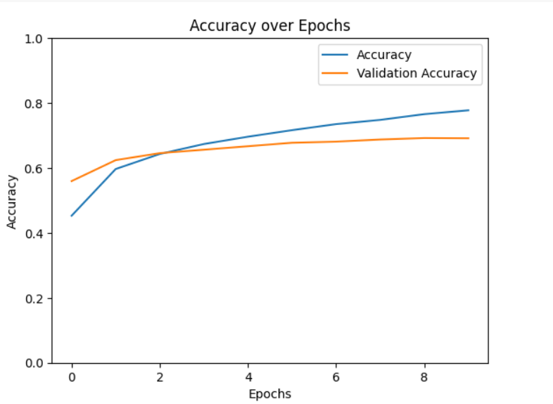
7. Model Evaluation
  Based on the test dataset
  Accuracy: 69,14%

Slide 11
8. Conclusion
  The developed CNN model learned to classify images from the CIFAR-10 dataset
  Training and validation accuracy provided insights into the model’s progress
  Evaluation of the model revealed its generalization capabilities (accuracy: 69%)

Slide 12
9. References
Chollet, F. (2021). Deep Learning with Python . Manning Publications.
Gupta, A. (2023) A comprehensive guide on Optimizers in deep learning, Analytics Vidhya. Available at: https://www.analyticsvidhya.com/blog/2021/10/a-comprehensive-guide-on-deep-learning-optimizers/ (Accessed: 16 January 2025).
Sharma, S. (2022) Activation functions in neural networks, Medium. Available at: https://towardsdatascience.com/activation-functions-neural-networks-1cbd9f8d91d6 (Accessed:16 January 2025).
VanderPlas, J. (2022). Python Data Science handbook. O'Reilly Media, Inc.

